Slide 1
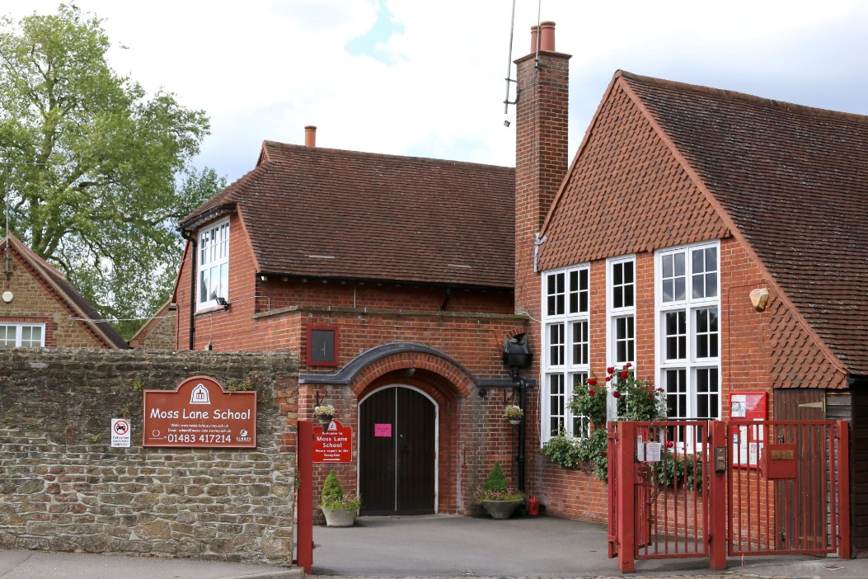
Welcome to Year One

Slide 2
Foxes Class
Teachers :
Miss Maddy Fox:
Mon, Tues, Wed
Mrs Georgie Cook:
Thurs, Friday
LSA: Mrs Mary King

Slide 3
Squirrels Class
Teachers:
Miss Carol Bowes:
Monday, Tuesday,
Miss Charlotte Hilyard:
Wednesday, Thursday, Friday
LSA: Ms Lois Pearson
LSA: Ms Cheryl Tickner

Slide 4
Welcome to Year 1:
This half term, much of our learning will focus on ensuring there is a smooth transition between EYFS and Key Stage One. Many lesson styles, routines and timetables are similar to those your children experienced when in the EYFS.
Your child has ample time to learn through play balanced with adult directed teaching sessions.
As the academic year progresses the Year One timetable will begin to change but opportunities to learn in practical ways will remain a high priority.
All staff are mindful that the Summer Term for your children was not a ‘typical’ Summer Term in EYFS and are planning teaching and learning accordingly.

Slide 5
Recovery Curriculum
The government have frequently referred to a ‘recovery curriculum’ when talking about children returning to more normal schooling after lockdown. A ‘recovery curriculum’ is not a set of learning objectives that schools have been directed to teach.
A ‘recovery curriculum’ refers to the adaptations schools are making to their established curriculum taking into consideration the extended school closure, remote learning and the impact lockdown may have had on children's emotional well being, as well as their education.
Each September, staff at Moss Lane carry out teacher led assessments over the first few weeks of the Autumn term. The findings of these assessments give a clear baseline of where the children are working at. It identifies the next steps of learning that need to take place, highlights those children who are ready to move on and those who would benefit from time to embed existing knowledge and skills even further.

Slide 6
Recovery Curriculum
As part of our recovery curriculum these teacher led assessments have taken place as normal with particular focus on phonics, reading and maths skills.
We are planning and timetabling in ample PHSE learning opportunities allowing the children to explore and unpick their experiences during lockdown. In school experiences are also allowing for children to re-establish friendships and rehearsal of vital social skills.
The recovery curriculum has a strong focus on the children's well being. This includes giving them time to re-establish effective learning behaviours to ensure any new learning will be received and embedded effectively.
Year one children are swiftly recapping phonics skills that were taught prior to school closure. This is to ensure this knowledge is embedded and children are using it independently in both reading and writing. It is ‘normal’ that phonics phases are recapped at the start of a new school year; this does not have a detrimental impact on children achieving end of year expectations.

Slide 7
Topics and learning in Year 1
Our topics this year are:
Busy Bodies;
Let’s Celebrate!;
Commotion in the Ocean;
I’ll Huff and I’ll Puff; What’s at the Bottom of my Garden?
Backpacks and Passports.
The teaching and learning in these topics covers science, history, geography, art & DT and RE.
Children will develop investigation skills and discover ways to find out new information.
At Moss Lane we work hard to provide a number of cross curricular links (linking subjects together).

Slide 8
Topics and learning in Year 1
In Maths children will explore addition and subtraction (and the symbols associated with each).
There will be a focus on Place Value. Children will learn how to identify and explain how many tens and ones are in numbers.
The children will be counting up to/across 100. They will learn how to read and represent these numbers.
Learning to count in 1s, 2s, 5s, and 10s is a key skill in Year One.
The children will secure their knowledge of number bonds to 10 and become familiar with number bonds to 20. They will learn how to use this knowledge in calculations.
They will also look at 2D and 3D shapes and their properties. The children will explore measure for length, capacity and mass using non standard units. Lessons will also cover Time and Money.
As the year progresses children will be encouraged to record their maths work in numerals, symbols and words. Forming numerals is rehearsed in year one.

Slide 9
Topics and learning in Year 1
In English, children will continue to expand and apply their phonic knowledge in both reading and writing.
They will be encouraged to write in full sentences, eventually using capital letters and full stops accurately. Some children will be using question marks and exclamation marks effectively by the end of year one.
They will be encouraged to become effective authors/writers by exploring how nouns, adjectives and verbs impact their writing.
By the end of the year children will be encourage to produce slightly longer pieces of writing. This will be supported by lots of talk and planning opportunities.
Children will experience reading and writing a variety of genres.
Phonics will still be a key in spelling but children will be taught an increasing number of words that they will be expected to recall correctly from memory.

Slide 10
Topics and learning in Year 1
Children will take part in daily ‘guided reading’ sessions. There are a range of reading related activities that occur during this time. The class teacher will read with a group of children during these sessions.
Children will be heard to read (individually) by the class teacher once a week with in a group. There will be times that the LSA also hears the children read. During assessment periods class teachers will hear children read on a one to one basis.
In year one children begin to recall many more words by sight as well as using their phonics skills to decode words. They will be encouraged to take notice of full stops, questions marks and punctuation.
Reading with fluency begins to develop in Year One. Children begin to develop the ability to read with expression.
There is a growing focus on comprehension in Key Stage 1; the ability to talk about what has been read. Children will be asked open ended questions about what they have read and be encouraged to find the answer in the text.

Slide 11
Letter formation /Handwriting
Letter formation practice takes place through a range of activities in year one; mark making, playdough, painting, sand trays etc… as well as more focussed handwriting sessions. Children do not explore ‘cursive’ style handwriting until their letter formation is secure.
Letter formation is rehearsed in ‘letter families’ as the basic structure of the letters are similar/follow similar patterns.
Curly caterpillar: a c o d g q e s f
ladder letters: l i t u j y
one armed robot: r b n h m k p
zig zags: v w x z

Slide 12
Karate Maths
Karate maths is an initiative that we use at Moss Lane to encourage children to rehearse and embed their mental maths skills. This develops quick recall of number facts!
There are grades/levels that children can work through. Each grade has different maths skills/knowledge for children to explore.
We encourage rehearsal of the appropriate skills to take place at home as well as at school.
Children will be awarded a certificate when teachers feel they have a secure recall of the number facts and skills in the appropriate grade.
There are full details of Karate Maths on the school website. A copy of all Karate Maths information will be emailed home shortly.

Slide 13
Home learning
Children will bring home a ‘Wonder book’. This will contain a short task linked to their learning in school. We feel this is great opportunity to make links with learning at home and at school.
Wonder Books will also include the focus sounds covered in phonics during the week and some year 1 ‘common exception words’ for the children to embed.
Home learning is sent home on a Thursday, to be returned on a Tuesday.
Reading: Ideally children will read their school books 5 times a week. Please write a short note in the diary. Book boxes will be put out in the classroom each morning so that your child may change their reading book if they have finished it.
Teachers will write a LT (learning to/target) in the reading diary. This can help give a bit of guidance when reading with your child.

Slide 14

Woodland school
Due to Covid restrictions we have been unable to book the education centre at Witley or hire National Trust staff. Therefore we are not yet able to timetable in dates for Woodland School sessions.
We are working to find solutions for this.

Slide 15
Things to consider
Our current start time is 8:55 am. Our day ends at 3:10 pm.
Pre/Post Covid restrictions: Children are dropped off at swiftly at their classroom door at 8:50 am (parents’ follow a one way system through school) and pick up is at 3:15 pm on the playground. When restrictions change, we will give further details about the start and end of day arrangements.
If your child is unable to attend school you must call the school office as soon as possible. You are able to leave a message explaining the reason for absence.
If your child is not attending school due to Covid symptoms or a Covid related issue, please ensure you share this information with the school as soon as possible.
Taking holiday during term time can mean children miss out on their education. However if you do need to take time out of school during term time, please complete and absence request form. This can be obtained by contacting the office.

Slide 16

Things to consider
Any new instructions regarding pick up at end of day are to be shared with the teacher at the start of the day. If there are changes during the day please call the office. Do not send this information via an email.
Taking photographs of children busy at work and play in school is common practice. These photos are often used in school displays, newsletters and the school website.
You signed a ‘photograph’ consent form when your child joined school. This specified the ways in which you were happy for us to use images of your child. If any details have changed, please contact the school
We are unable to have parent volunteers in school currently due to Covid restrictions. However when we are able to accommodate volunteers we will be in contact.

Slide 17
Children’s belongings
Please ensure all belongings that come into school are clearly named.
Please ensure your child brings in their reading diary, book and book bag everyday . Please support your child in becoming responsible for handing letters to teachers etc...
Water bottles – please ensure they are filled up. Please only send your child in with water.
Current process for PE – children to come to school in kit. Year One have PE on Tuesday and Wednesday.
Pre/post Covid restrictions - PE kits remain in school for half a term and are stored on your child's peg in a suitable bag.

Slide 18
Food and drink
Children are offered a piece of fruit for snack each morning at break time (around 10.00am/10.30am)
Milk is available through ‘Cool Milk’. Please sign up if you would like your child to receive milk each day.
School Dinners continue to be provided by Innovate. Please ensure meals are booked in time for the following week. If there are changes to your child’s dietary requirements (allergies/intolerances) please contact the school.
We are a school that holds a ‘Healthy Eating’ badge. We do not encourage the handing out of sweet treats for birthday celebrations.

Slide 19
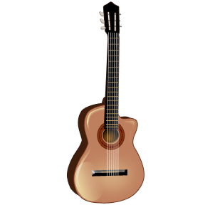
Extra Curricular Activities
Current provision: SCL are running a Multi Skills & a Football club. Please book directly with SCL via their website.
Pre/post Covid restrictions : Clubs such as drama, dance, piano, guitar and judo are offered by various outside agencies. Full details will be shared when these clubs are able to run from Moss Lane again.

Slide 20

Children are taught how to keep themselves safe, whilst working online. They are reminded that these rules apply to both home and school life.
Below are examples of the language that children are used to hearing when talking about online safety. The dolphin is called ‘Hector the Protector’. Children are taught to click on Hector if they see something that makes them feel uncomfortable or scared. These ‘clicks’/reports are monitored and checked.
.
E-safety:
I will take care of the school computers.
I will only use the internet when an adult says I can.
 | I will tell an adult if I feel unsafe.
 | I will not tell other people personal things about me.
 | I will be polite and friendly when I write messages.

Slide 21
Thank you for reading.
Please do email us if you have any questions.
chilyard@moss-lane.surrey.sch.uk
cbowes@moss-lane.surrey.sch.uk
mfox@moss-lane.surrey.sch.uk
gcook@moss-lane.surrey.sch.uk

